Slide 1
Processes
CS422/522 Lecture 6
15 September 2014
Last updated: 14 September 2014
张义飞 2015

Slide 2
Outline
Recap
Building a Process
Lifetime of a Process
Userspace
Threads
Multiprocessor Computers
Wrap-Up

Slide 3
Recap
Interrupts vs Exceptions
Traps vs Faults
System calls and DPL
IRQs -- Hardware Interrupts
张义飞 2015

Slide 4
Outline
Recap
Building a Process
Lifetime of a Process
Userspace
Threads
Multiprocessor Computers
Wrap-Up

Slide 5
Process States
unused
embyro -- new
sleep -- waiting
runnable -- ready
run
zombie -- terminated
张义飞 2015

Slide 6
Building a Process
Acquire necessary kernel state:
  Valid PID
  Process structure
Memory layout:
  Kernel code and data -- faster exception / interrupt handling
  Application code and data -- where? elf or fixed
  Stack -- where? specific area or end of data page
Setting the initial CPU state:
  Set segmentation registers to user code
  Enable interrupts
  Set the stack pointer
  Set the instruction pointer
张义飞 2015

Slide 7
Xv6 Initial Program Setup

Slide 8
for(p = ptable.proc; p < &ptable.proc[NPROC]; p++) if(p−>state == UNUSED) goto found; return 0; found: p−>state = EMBRYO; p−>pid = nextpid++; release(&ptable.lock);
// Allocate kernel stack. if((p−>kstack = kalloc()) == 0){ p−>state = UNUSED; return 0;
} sp = p−>kstack + KSTACKSIZE;
Kernel State

Slide 9
Memory Setup
if((p−>pgdir = setupkvm()) == 0)
panic("userinit: out of memory?");
inituvm(p−>pgdir, _binary_initcode_start,
(int)_binary_initcode_size);

Slide 10
Loading the Application Data
// Load the initcode into address 0 of pgdir.
// sz must be less than a page. void inituvm(pde_t *pgdir, char *init, uint sz)
{ char *mem; if(sz >= PGSIZE) panic("inituvm: more than a page"); mem = kalloc(); memset(mem, 0, PGSIZE); mappages(pgdir, 0, PGSIZE, v2p(mem), PTE_W|PTE_U); memmove(mem, init, sz);
}

Slide 11
Preparing the User CPU State
// Leave room for trap frame. sp −= sizeof *p−>tf; p−>tf = (struct trapframe*)sp;
... memset(p−>tf, 0, sizeof(*p−>tf)); p−>tf−>cs = (SEG_UCODE << 3) | DPL_USER; p−>tf−>ds = (SEG_UDATA << 3) | DPL_USER; p−>tf−>es = p−>tf−>ds; p−>tf−>ss = p−>tf−>ds; p−>tf−>eflags = FL_IF; p−>tf−>esp = PGSIZE; p−>tf−>eip = 0; // beginning of initcode.S

Slide 12
Outline
Recap
Building a Process
Lifetime of a Process
Userspace
Threads
Multiprocessor Computers
Wrap-Up

Slide 13
Lifetime of a Process
Starting a process
Suspending a process
Resuming a process
Terminating a process

Slide 14
Starting a Process
How do we (typically) enter kernel mode? exceptions
The process:
Setup kernel stack as if interrupt occurred
Call iret to pop back into user mode

Slide 15
Suspending a Process
Mechanisms for Suspending a Process:
Explicitly yielding
Waiting for another process
Waiting on an event
System timer
What triggers these? exceptions / interrupts

Slide 16
Resuming a Process
Not all that different from starting
Pick a process (scheduling)
Use an iret as a software context switch

Slide 17
Terminating a Process
Reasons for terminating a process:
end of execution
user terminated
illegal action
What needs to be done?
Clean up open files
Release process
Free memory

Slide 18
Xv6 Process Lifetime

Slide 19
Preparing the Process
// Set up new context to start executing at forkret,
// which returns to trapret.
sp −= 4;
*(uint*)sp = (uint)trapret; // lecture 5
sp −= sizeof *p−>context;
p−>context = (struct context*)sp;
memset(p−>context, 0, sizeof *p−>context);
p−>context−>eip = (uint)forkret;

Slide 20
Starting the Process
// Switch to chosen process. It is the process’s job
// to release ptable.lock and then reacquire it
// before jumping back to us.
proc = p;
switchuvm(p);
p−>state = RUNNING;
swtch(&cpu−>scheduler, proc−>context);

Slide 21
swtch
swtch:
movl 4(%esp), %eax movl %esp, (%eax)
movl 8(%esp), %edx movl %edx, %esp
# Save old callee−save registers # Load new callee−save registers
pushl %ebp popl %edi
pushl %ebx popl %esi
pushl %esi popl %ebx
pushl %edi popl %ebp
# Switch stacks ret

Slide 22
swtch -- digested
Complex bit of code... high level...
Swap CPU kernel context to process kernel context
Save important registers
Swap stacks
Restore registers
Go to the stored eip (forkret)
forkret will think that it was called by trapret

Slide 23
Let's consider a yield
We don't actually have this system call, but it is easy to add (try it at home!)
// in some user application
yield();
.globl yield
yield:
movl $SYS_ yield, %eax
int $T_SYSCALL
ret

Slide 24
In the Kernel
void
yield(void)
{
acquire(&ptable.lock);
proc−>state = RUNNABLE;
sched();
release(&ptable.lock);
}

Slide 25
Swapping contexts back to the scheduler
sched(void)
{
int intena;
intena = cpu−>intena;
swtch(&proc−>context, cpu−>scheduler);
cpu−>intena = intena;
}
The CPU will find another process to run and call swtch on it.

Slide 26
Termination (misbehavior)
default:
// In user space, assume process misbehaved.
cprintf("pid %d %s: trap %d err %d on cpu %d "
"eip 0x%x addr 0x%x−−kill proc\n",
proc−>pid, proc−>name, tf−>trapno, tf−>err, cpu−>id, tf−>eip,
rcr2());
proc−>killed = 1;
// Force process exit if it has been killed and is in user space.
// (If it is still executing in the kernel, let it keep running
// until it gets to the regular system call return.)
if(proc && proc−>killed && (tf−>cs&3) == DPL_USER)
exit();

Slide 27
exit -- files
exit(void)
{
struct proc *p;
int fd;
// Close all open files.
for(fd = 0; fd < NOFILE; fd++){
if(proc−>ofile[fd]){
fileclose(proc−>ofile[fd]);
proc−>ofile[fd] = 0;
}
}
iput(proc−>cwd); // file system stuff
proc−>cwd = 0;

Slide 28
exit -- processes
// Parent might be sleeping in wait().
wakeup1(proc−>parent);
// Pass abandoned children to init.
for(p = ptable.proc; p < &ptable.proc[NPROC]; p++){
if(p−>parent == proc){
p−>parent = initproc;
if(p−>state == ZOMBIE)
wakeup1(initproc);
}
}
// Jump into the scheduler, never to return.
proc−>state = ZOMBIE;
sched();
panic("zombie exit");
}

Slide 29
Freeing memory
Parents job, happens once the parent waits
kfree(p−>kstack);
p−>kstack = 0;
freevm(p−>pgdir);

Slide 30
Freeing memory
freevm(pde_t *pgdir)
{
uint i;
if(pgdir == 0)
panic("freevm: no pgdir");
deallocuvm(pgdir, KERNBASE, 0);
for(i = 0; i < NPDENTRIES; i++){
if(pgdir[i] & PTE_P){
char * v = p2v(PTE_ADDR(pgdir[i]));
kfree(v);
}
}
kfree((char*)pgdir);
}

Slide 31
Outline
Recap
Building a Process
Lifetime of a Process
Userspace
Threads
Multiprocessor Computers
Wrap-Up

Slide 32
Userspace
init -- initial system process
System call: fork
New application system call:exec

Slide 33
init
Loads additional kernel module
Starts any necessary services
Starts the user interface (login + shell / gui)

Slide 34
Xv6 init
for(;;){
printf(1, "init: starting sh\n");
pid = fork();
if(pid < 0){
printf(1, "init: fork failed\n");
exit();
}
if(pid == 0){
exec("sh", argv);
printf(1, "init: exec sh failed\n");
exit();
} printf(1, "zombie!\n");
while((wpid=wait()) >= 0 && wpid != pid) }

Slide 35
fork
Duplicates calling process
Allocates a unique PID
pid_t fork(void):
in child, pid == 0
in parent, pid > 0

Slide 36
fork
fork(void)
...
if((np = allocproc()) == 0)
...
if((np−>pgdir = copyuvm(proc−>pgdir, proc−>sz)) == 0){
...
np−>sz = proc−>sz;
np−>parent = proc;
*np−>tf = *proc−>tf;
np−>tf−>eax = 0; // child returns 0 np−>cwd = idup(proc−>cwd);
for(i = 0; i < NOFILE; i++) ...
if(proc−>ofile[i]) np−>state = RUNNABLE;
np−>ofile[i] = filedup(proc−>ofile[i]); return np->pid;

Slide 37
exec
Replaces existing process image with new application
Requires a new virtual memory mapping, erasing previous
Read from disk application and store in new vm
Set eip as entry point into application

Slide 38
// IT IS TOO BIG! Lots of error checking
// and similar code bits as before

Slide 39
Outline
Recap
Building a Process
Lifetime of a Process
Userspace
Threads
Multiprocessor Computers
Wrap-Up

Slide 40
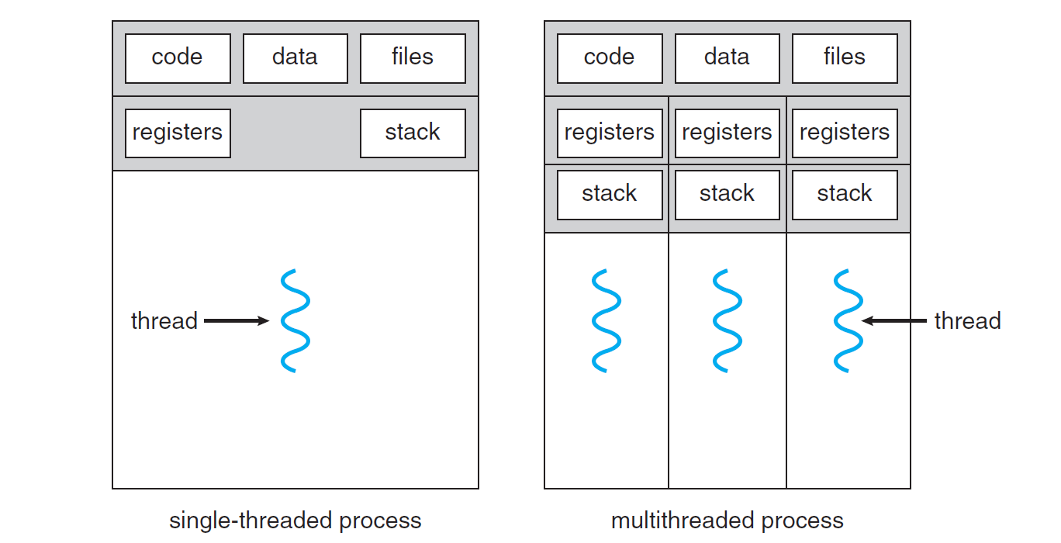
Threads
Process duplicates everything
Thread is same context, different register state

Slide 41
Thread (Process) State
Code
Data
Stack
Files

Slide 42
Types of threads
user:
Share a single process -- many-to-one
Cooperative multiprocessing
Must overcome blocking operations
kernel:
Each has a process -- one-to-one
Slightly slower context switch
user+kernel:
More flexibility -- many-to-many
Threadpools -- why not done in kernel?

Slide 43
Outline
Recap
Building a Process
Lifetime of a Process
Userspace
Threads
Multiprocessor Computers
Wrap-Up

Slide 44
Multiprocessor Computers
OS - illusion of multiple processes running at same time
Multiprocessor - multiple processes running at same time
Two approaches:
Asymmetric -- 1 leader, all worker processors
Symmetric -- all work together

Slide 45
Multiprocessor Approaches
Asymmetric:
No sharing of memory -- easier to program
Requires a monitoring process, may be less efficient
Symmetric:
Each processor runs own scheduler (chooses what to run) -- more efficient
Shares kernel data structures -- must be prepared for race conditions

Slide 46
xv6 overview
After boot CPU starts all services...
Prepare other CPUs
Send IPI
The other CPUs start in entryother.S
Other CPUs share the same page directory
Everyone meets in mpmain
Everyone begins looking for processes to run

Slide 47
Outline
Recap
Building a Process
Lifetime of a Process
Userspace
Threads
Multiprocessor Computers
Wrap-Up

Slide 48
Lots and lots of processes
How to protect kernel from multiple processes changing state at the same time
How to share the CPU(s) with multiple processes
How to communicate across processes

Slide 49
Grades for Lab 0, Lab 1, Lab 2
Lab 0 (Shell) - 45/50
Lab 1 Code - 49/50
Lab 1 Questions - 35/40
Lab 2 forthcoming
Question / Answer session next Wednesday

Slide 50
Next Time
Wednesday 1:00PM
Synchronization

